Slide 1

GENETICS
Mutations, Pedigree diagrams dihybrid crossings, genetic engineering

Slide 2

MUTATIONS
The unexpected change in genetic structure of a cell.
CAUSE: Mutations occur suddenly and randomly and may be caused by many environmental agents such as X-rays and certain chemicals.
TWO TYPES:
Gene mutations are mutations that affect a single or a few base pairs in just a single gene.
Chromosomal aberrations refer to changes in the normal structure or number of chromosomes.
EFFECTS:
Harmful mutations cause changes in DNA that can cause errors in protein sequencing, that can result in partially or completely non­ functional proteins.
Harmless mutations have no effect on the structure or functioning of the organism.
Useful mutations can be advantageous to the organism and they are passed on from parent to offspring.

Slide 3
GENE MUTATIONS
• Haemophilia: Absence of the protein needed for the formation of blood clots
due to a mutant gene.
• Colour blindness: Absence of the proteins that make up either the red or green
cones/photoreceptors in the eye.
• Albinism: Absence of the protein that forms the pigment melanin.
CHROMOSOMAL ABERRATIONS
Down syndrome: There is an extra chromosome (47 instead of 46) in the zygote.

Slide 4
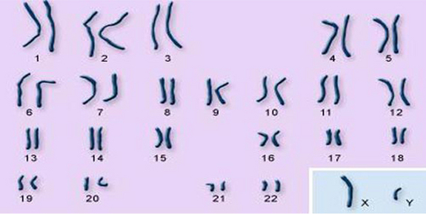
SEX-LINKED INHERITANCE
Autosomes
Gonosomes/sex chromosomes
Genes located on a sex chromosome are called sex linked genes.
In humans the term usually refers to X-linked characteristics: genes located only on X chromosomes.
Fathers can pass X-linked alleles to their daughters, but not sons.
Mothers can pass sex-linked alleles to both sons and daughters.

Slide 5
SEX-LINKED DISEASES
If a sex linked trait is due to a recessive allele:
A female will express the phenotype only if she is homozygous recessive.
If a male receives the recessive allele from his mother he will express the phenotype.
Far more males have disorders that are inherited as sex linked recessives than females.
Examples: Colour blindness
Haemophilia

Slide 6
SEX LINKED INHERITANCE - HAEMOPHILIA
Haemophilia is caused by a recessive allele on the X-chromosome. Males have only one X-chromosome – they mainly suffer from this disorder.
Cross a mother who is normal but a carrier, with a haemophiliac father.
P₁ phenotype Male haemophiliac x Female normal
genotype X^{h}Y x X^{H}X^{h}
Meiosis
Gametes X^{h} Y X^{H} X^{h}
Fertilisation
F₁ Genotype: X^{H}X^{h}, X^{h}X^{h}, X^{H}Y, X^{h}Y
Phenotype: Normal Haemophilia Normal Haemophilia
female female male male
Gametes | X^{h} | Y
X^{H} | X^{H}X^{h} | X^{H}Y
X^{h} | X^{h}X^{h} | X^{h}Y

Slide 7
GENETIC PEDIGREE DIAGRAMS
Shows the pattern of inheritance of characteristics over a few generations
Follow the following steps when interpreting pedigree diagrams:
Study any key and opening statement/s and look for dominant characteristics and phenotypes
Fill in the genotype of all the individuals with the recessive condition- it has to have 2 lower case letters e.g. ff
For every individual in the diagram that has the recessive condition, it means that each gene was obtained from each of the parents. Work backwards and fill in one recessive gene for each parent.
If the parents showed the dominant characteristic fill in the second letter which has to be a capital letter.
Any other individual showing the dominant characteristic will most likely be homozygous dominant – two capital letters.

Slide 8
Example – earlobes Please note: Unattached earlobes are dominant (F) and Attached earlobes are recessive (f)– complete missing genotypes
ff
Ff
Ff
ff
ff
Ff
Ff
ff
Ff
ff
Key:
Recessive
Recessive
Male with attached earlobes
Male with unattached earlobes
Female with attached earlobes
ff
Ff
Female with unattached earlobes

Slide 9
Activity 1 The diagram below shows the inheritance of broad/thin lips in humans. Broad lips (B) is dominant over thin lips(b). Individual 2 is homozygous. Use the letters B and b and write down the phenotypes and genotypes of the individuals.
2
Key:
Male with broad lips
Female with blue eyes
Male with thin lips
Female with broad lips
Female with thin lips

Slide 10
Memo Activity 1 Complete the following activity in pairs The diagram below shows the inheritance of broad or thin lips in humans. Broad lips (B) is dominant over thin lips(b). Individual 2 is homozygous. Use the letters B and b and write down the phenotypes and genotypes of individuals
bb
BB
thin
broad
Bb
Bb
bb
Broad
Broad
Broad
Key:
Male with broad lips
Recessive
Recessive
Male with thin lips
Female with broad lips
bb
Bb
Bb
bb
bb
Female with thin
thin
Broad
thin
thin
Broad

Slide 11
Dihybrid cross
Steps to follow | What to do
Step 1 | Identify the phenotypes of the two organisms for each of the two characteristics. Tall yellow flowers x Tall orange flowers
Step 2 | Choose letters to represent the alleles for the gene responsible for each characteristic. Tall =(T); Short = (t) ; Yellow (Y); orange (y)
Step 3 | Write the genotypes of each parent. for example: TtYy x Ttyy
Step 4 | • Determine the possible gametes that each parent can produce. • Remember that each parent will have two alleles for each gene. • The gametes of each parent will have only one allele for each gene because of segregation during meiosis.
 | T | t
Y | TY | tY
y | Ty | ty
 | T | t
y | Ty | ty
y | Ty | ty

Slide 12
Dihybrid cross
Steps to follow | What to do
 | Remember that because of Mendels principle of Independent assortment an allele for one gene could appear in the same gamete with any of the alleles for the other gene.
Step 5 | Enter the possible gametes at the top and side of a Punnett square.
 | TY | ty | Ty | tY
Ty
Ty
ty
ty

Slide 13
Step 6 | • Because of random fertilisation, gametes from both parents could fuse in different combinations to form the offspring. • In the Punnet square, write down the genotypes of the offspring that will result from each possible combination of gametes.
Step 7 | Determine the phenotypes of the offspring from the genotypes obtained in the Punnet square.
 | TY | ty | Ty | tY
Ty | TTYy | Ttyy | TTyy | TtYy
Ty | TTYy | Ttyy | TTyy | TtYy
ty | TtYy | ttyy | Ttyy | ttYy
ty | TtYy | ttyy | Ttyy | ttYy

Slide 14
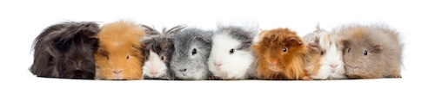
Activity
A guinea pig with black (B), long fur (L) is crossed with a guinea pig with brown (b), short fur (l). Both parents are homozygous. The F1 offspring were interbreed, use a diagrammatic cross to show the genotype and phenotypes of the F2 generation and as well as the phenotypic ratio.

Slide 15
Memo Activity:
P2 Phenotype:
black and long fur x black and long fur
Genotype: BbLl x BbLl
Meiosis
Gametes: BL, Bl, bL, bl x BL, Bl, bL, bl
Fertilisation
F2 genotype:
 | BL | Bl | bL | bl
BL | BBLL | BBLl | BbLL | BbLl
Bl | BBLl | BBll | BbLl | Bbll
bL | BbLL | BbLl | bbLL | bbLl
bl | BbLl | Bbll | bbLl | bbll
Phenotype ratio

Slide 16
Memo Activity
Phenotype 9 black long
3 black short fur
3 brown long fur
1 brown short fur
Black long : black short : brown long : brown short
9 : 3 : 3 : 1

Slide 17
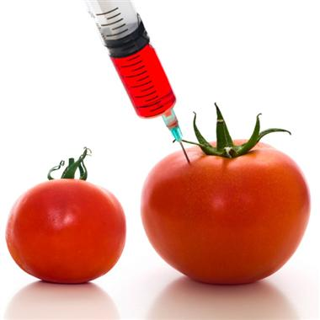
GENETIC ENGINEERING
Genetic engineering
Genetic engineering is the process whereby the genes on the DNA are changed, transferred or manipulated to produce a different organism.
Genetic counselling
Couples with a risk of a genetic disease can undergo genetic counselling to enable them to make informed decisions on whether they want to have children or not.

Slide 18
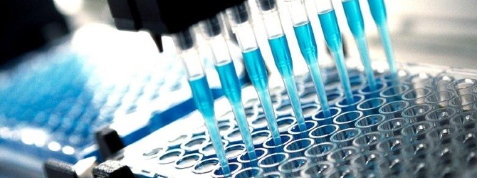
Biotechnology
Biotechnology is the use of living systems and organisms to develop or make products, or "any technological application that uses biological systems, living organisms or derivatives thereof, to make or modify products or processes for specific use" (UN Convention on Biological Diversity, Art. 2).

Slide 19
Stem cell research
What are stem cells?
Cells that have the potential to develop into many different cell types in the body.
Sources
Embryonic stem cells derived from embryos and somatic stem cells which are derived from adult tissue
Uses
Used for treating diseases (like diabetes and heart disease)

Slide 20
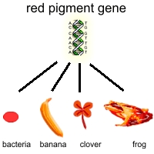
Genetic Modification
Genetic engineering, also called genetic modification, is the direct manipulation of an organism's genome using biotechnology. It is a set of technologies used to change the genetic makeup of cells, including the transfer of genes within and across species boundaries to produce improved or novel organisms.

Slide 21
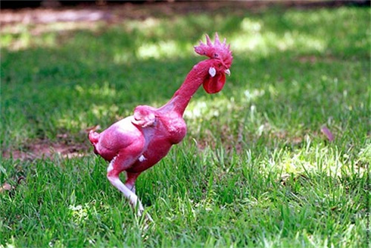
GMO
GM plants
-Between 70% and 80% maize in SA is GMO
-Bt crops – contain the protein (Bt) which kills bugs if they digest it. Less pesticide needed.
GM animals
Enviropig, featherless chicken, sudden death mosquitoes, fast growing salmon. Each has it own benefits.
Objections
- Playing with nature/God
- Not safe (health wise)
- Not good for the environment

Slide 22
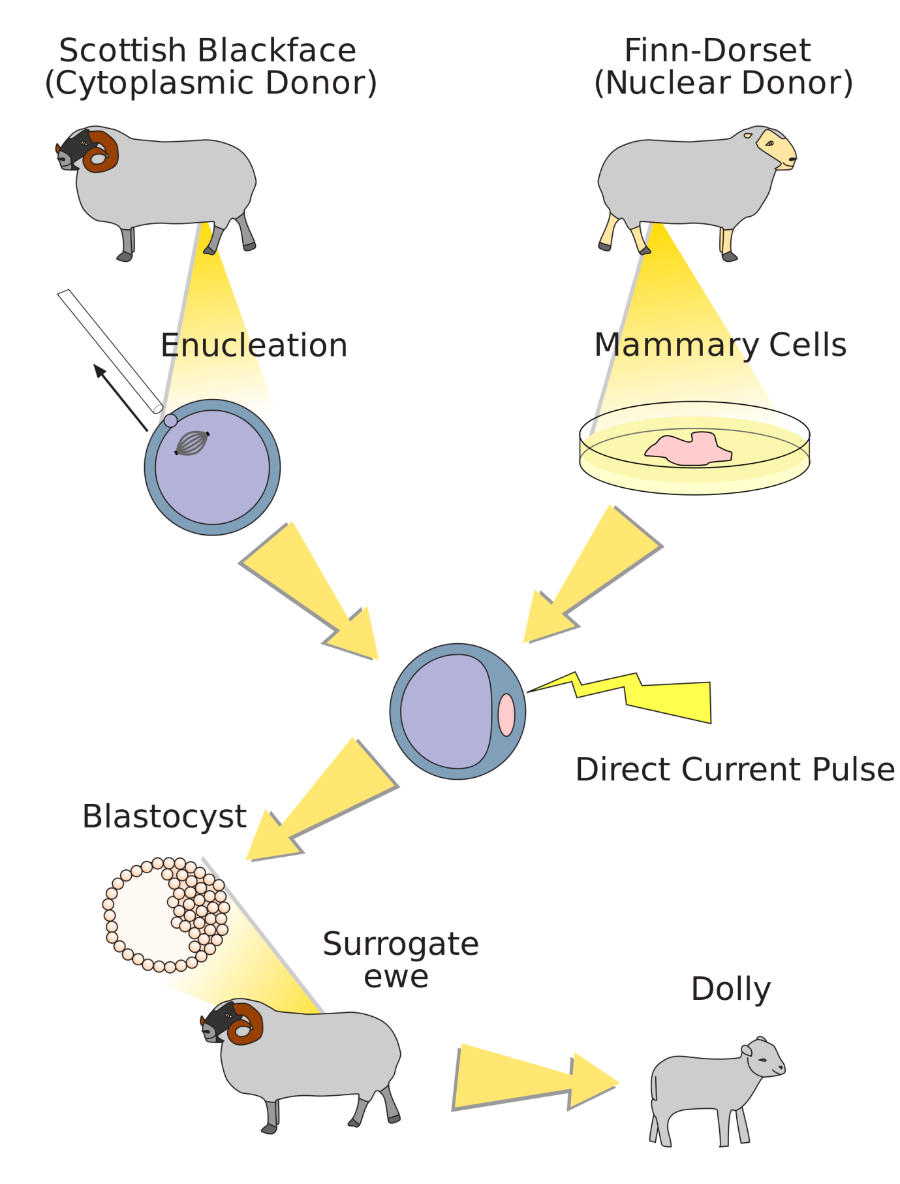
Cloning
In biology, cloning is the process of producing similar populations of genetically identical individuals that occurs in nature when organisms such as bacteria, insects or plants reproduce asexually.

